Slide 1
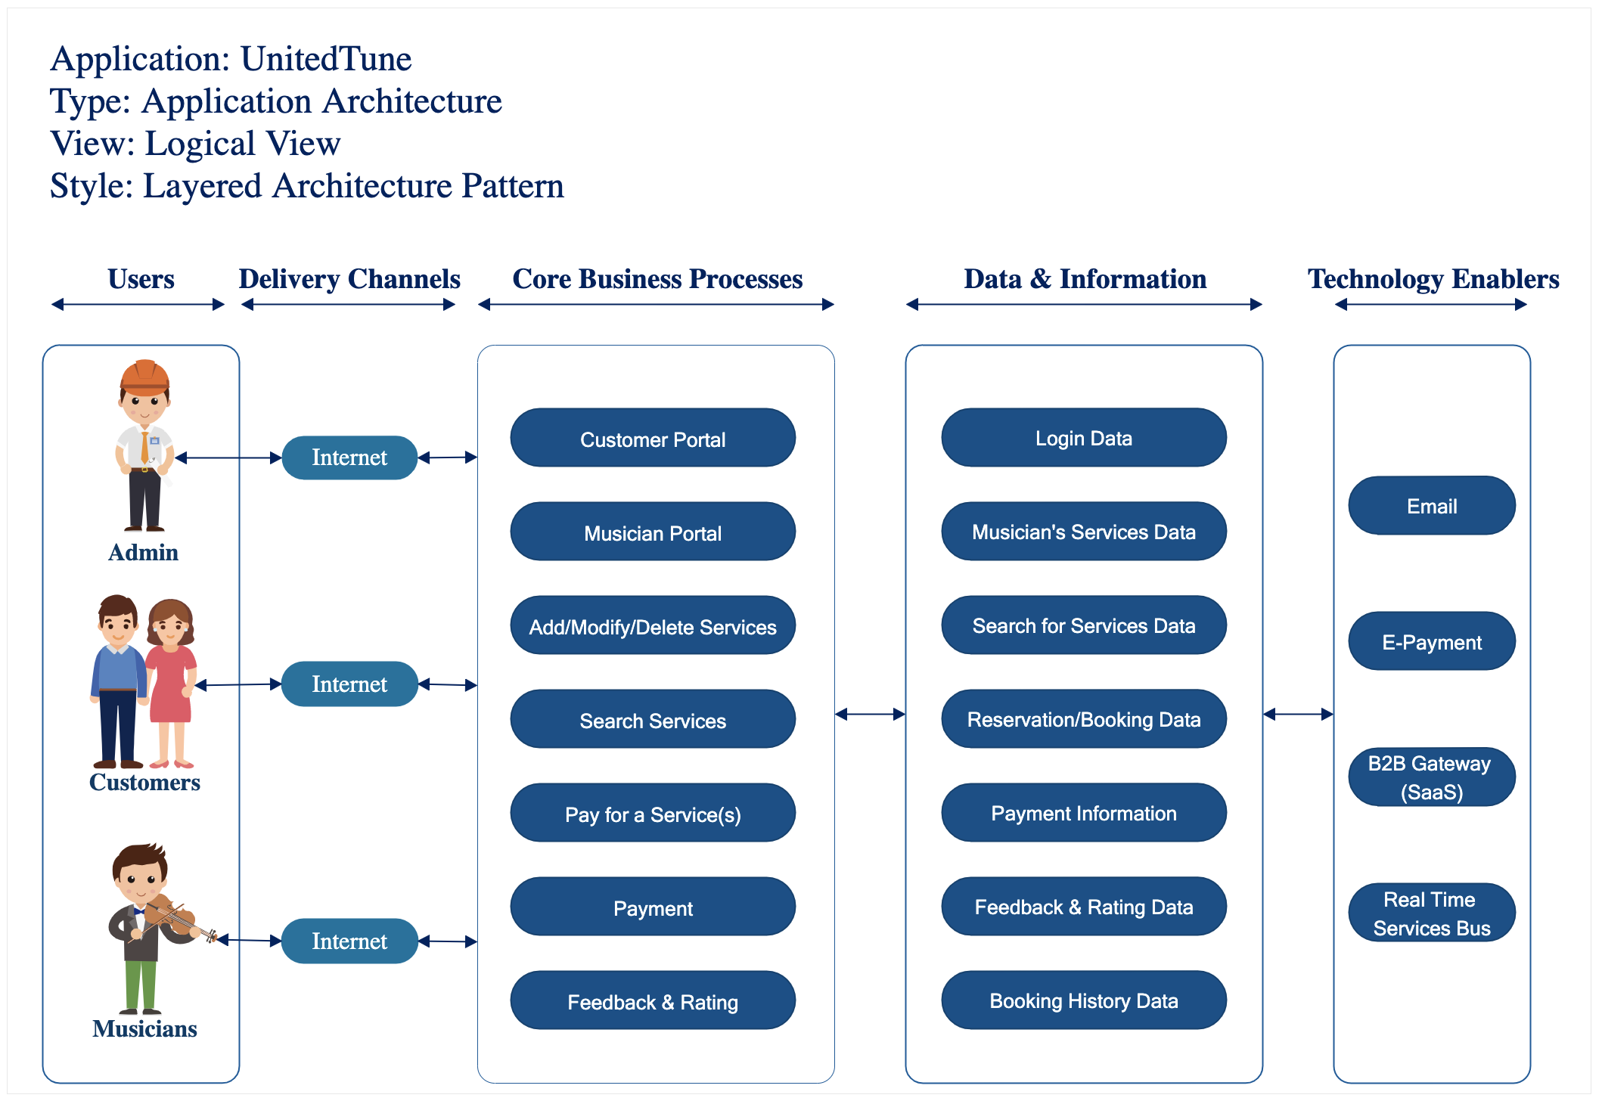
Architecture Diagram: Logical View

Slide 2
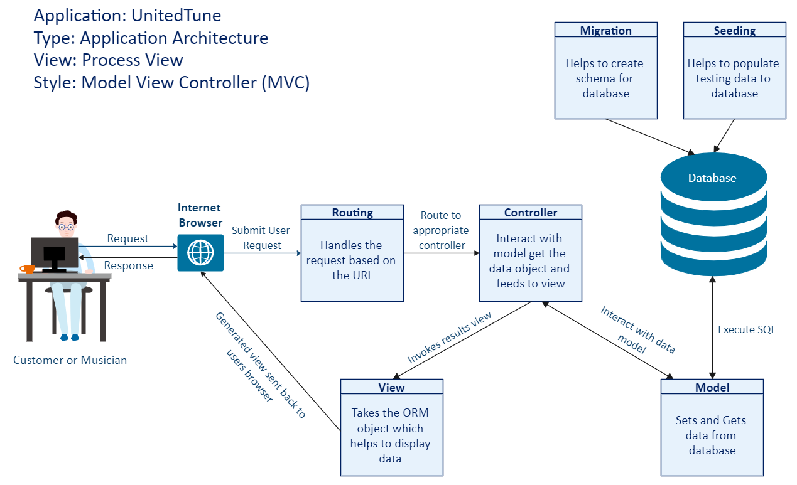
Architecture Diagram: Process View

Slide 3
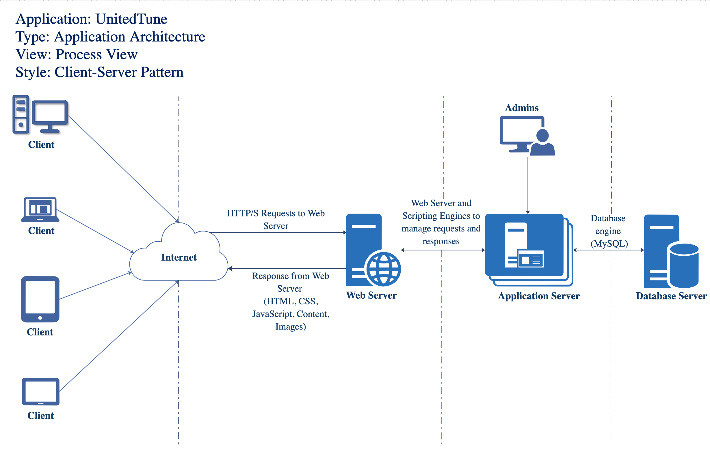
Architecture Diagram: Process View

